Slide 1

INTERNSHIP Project on MERN-Based Prompt and Mail Management System
Hindustan College of Science and Technology, Farah, Mathura
Department of Information Technology
Company Name:
Udemy
Student Name:
Mitanshu Sharma
Roll No.
2200640130029
Semester:
V
Duration:
4 weeks

Slide 2
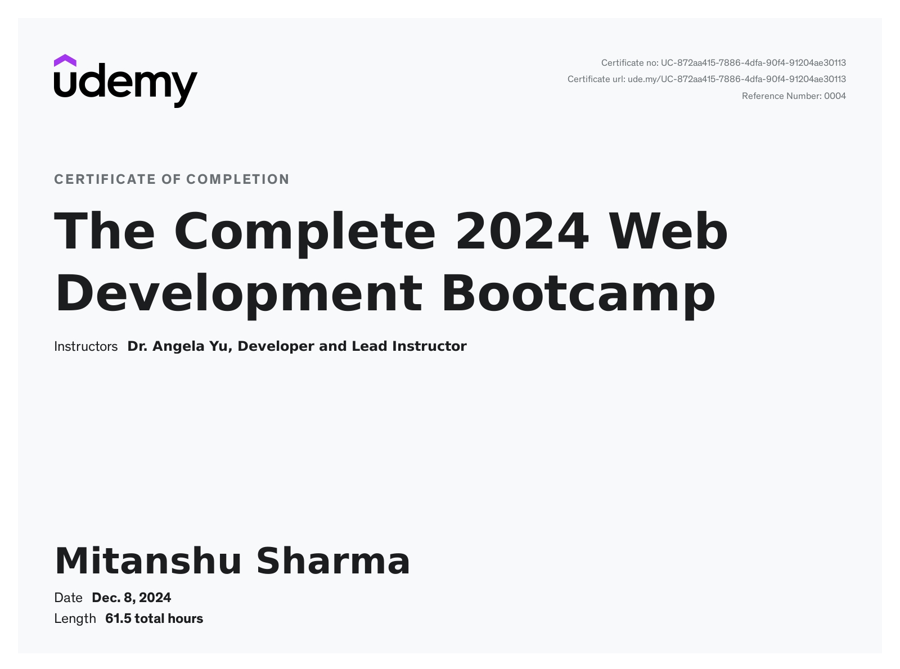
CERTIFICATE

Slide 3
Presentation Outline
Introduction
System Analysis
Literature Survey
Feasibility Study
Requirement Specification
System Design
Testing
Snapshots
Key Learnings and Challenges
Future Enhancements
Conclusion and Acknowledgments

Slide 4
INTRODUCTION- COMPANY PROFILE(Udemy)
Course Access:
Students can browse and enroll in a vast library of courses across various fields like technology, business, design, and personal development, tailored to their needs and interests.
Flexible Learning:
Udemy provides lifetime access to purchased courses, allowing students to learn at their own pace, anytime and anywhere, through both web and mobile platforms.
Interactive Features:
Students can engage with instructors and fellow learners through Q&A forums, quizzes, assignments, and downloadable resources to deepen their understanding of the material.

Slide 5
INTRODUCTION
Project Title:
MERN-Based Prompt and Mail Management System
Purpose of the Project:
Automate email drafting and sending using AI-powered prompts.
Enable users to customize drafts before sending emails.
Log user-specific email activities for easy tracking.
Problem Solved:
Reduces the time required for drafting emails.
Centralizes email records for better transparency and accountability.
Technology Stack:
MERN (MongoDB, Express.js, React.js, Node.js), Tailwind CSS and Gemini API for AI integration.

Slide 6
SYSTEM ANALYSIS – OBJECTIVES
Automation of Email Drafting:
The core objective is to automate the process of drafting emails using AI-powered prompts. This significantly reduces the time needed for email composition.
Customizability for Users:
Users can personalize the AI-generated drafts, ensuring that emails are suited to specific requirements.
Bulk Emailing:
The application should allow sending emails to multiple recipients at once, making it ideal for both personal and business use.
Email Activity Logs:
Keep a detailed log for each user, tracking sent emails, their recipients, and timestamps, allowing for easy review of past communication.
Security & User-Friendliness:
The application should be simple to use, even for non-technical users, while also ensuring that user data is secure through encryption and secure login mechanisms.

Slide 7
SYSTEM ANALYSIS – PROBLEM STATEMENT
Manual Drafting Issues:
Drafting personalized emails for multiple recipients takes a lot of time and effort, especially when the content needs to be tailored for each person.
Recipient Management Challenges:
Sending emails to a large group of people can become error-prone, especially when managing the recipients individually.
Lack of Tracking and Transparency:
Without an effective system to log email activities, users might struggle to recall past emails sent, or the recipients for a particular email.
Time-Consuming Email Management:
Creating a system that simplifies both the email creation and tracking process can save users substantial amounts of time.

Slide 8
LITERATURE SURVEY – TOOLS AND TECHNOLOGIES
MERN Stack (MongoDB, Express.js, React.js, Node.js):
MongoDB: A flexible, scalable NoSQL database used for storing data such as users, emails, and logs.
Express.js: A back-end web framework that simplifies routing and API handling in Node.js.
React.js: A popular front-end library for building dynamic and interactive user interfaces.
Node.js: A JavaScript runtime that handles server-side logic and interacts with the database and Gemini API.
Tailwind CSS: Tailwind is a utility-first CSS framework that allows for rapid and responsive UI design.
Gemini API: The Gemini API powers the AI-based content generation, which assists in drafting emails based on user inputs.

Slide 9
LITERATURE SURVEY – SKILLS ACQUIRED
Full-Stack Development: Proficiency in using the MERN stack to build a complete, functioning web application, including both the front-end and back-end.
API Integration: Gained expertise in integrating third-party APIs, such as Gemini, to expand the functionality of a web application.
Database Management: Experience with MongoDB to manage user information, email content, and logs. This includes understanding schema design, data storage, and retrieval operations.
Tailwind CSS: Mastered the use of Tailwind CSS to design a responsive, modern user interface with minimal custom CSS. Tailwind’s utility classes allowed for a faster and more flexible design process.

Slide 10
FEASIBILITY STUDY – TECHNICAL FEASIBILITY
Compatibility of Technologies: The MERN stack is well-suited for creating scalable web applications. Integration of Gemini API is seamless, as it can handle real-time requests for email drafting.
Scalability and Performance: MongoDB’s flexible schema and Node.js’s non-blocking I/O make the system scalable. As more users are added, the system can handle increased traffic without compromising speed.
Security Measures: Passwords are safely sent to express server, and user data is stored securely in MongoDB.
Tailwind CSS Integration: Tailwind enables rapid development and ensures the UI is both responsive and adaptive, making the app usable across devices with minimal effort.

Slide 11
FEASIBILITY STUDY – ECONOMIC FEASIBILITY
Development Costs: The use of open-source tools like the MERN stack and Tailwind CSS minimizes upfront development costs.
API Usage: Gemini’s free-tier API access allows for low-cost initial development. As the system scales, paid plans may be considered.
Maintenance Costs: Regular updates and maintenance, such as bug fixes, security patches, and feature upgrades, are important for long-term system sustainability. Open-source tools help minimize recurring maintenance costs.
Long-term ROI: The time saved by automating the email drafting and sending process offers significant returns, especially for businesses or organizations with regular email outreach needs.
Scalability: The system is designed to grow with the business, handling increased demand without major rework or additional infrastructure costs.

Slide 12
FEASIBILITY STUDY – OPERATIONAL FEASIBILITY
User Interface Design: The application is designed with simplicity in mind. Users can quickly navigate between submitting prompts, editing drafts, and sending emails. Tailwind CSS ensures the UI is modern and appealing to user.
Operational Efficiency: The system is optimized to handle multiple users concurrently without delays in email generation or sending. The back-end uses caching mechanisms to speed up frequently used data retrieval.
Real-World Use Cases: The system is practical for individuals, businesses, and organizations needing efficient, automated email management. The ability to send personalized emails to large groups is invaluable in marketing, customer service, and other fields.

Slide 13
REQUIREMENT SPECIFICATION – FUNCTIONAL REQUIREMENTS
User Authentication: A secure login system ensures that only authorized users can access their account and data. Authentication is handled using a simple login system, ensuring session integrity and security.
Prompt Submission: Users can submit a prompt (e.g., "Write an email to schedule a meeting") to the Gemini API to generate a draft email.
Email Customization: Users can edit the draft emails, modify the content, and add personalized information before sending them.
Bulk Email Sending: The system allows users to input multiple recipients and sends customized emails to each recipient in one go.
Email Activity Logs: Every email sent by the user is logged with details about the content, recipients, timestamps, and the email status (sent/failed).

Slide 14
REQUIREMENT SPECIFICATION – NON-FUNCTIONAL REQUIREMENTS
Security Features:
Encryption: All sensitive data (e.g., user passwords, email contents) is safley stored in our backend server and database.
Authentication: Users’ data is protected using a simple login system, ensuring basic authentication security.
Scalability and Performance: The system is capable of handling growing amounts of users and email data. MongoDB’s flexible schema allows for easy scaling, while Node.js handles multiple requests simultaneously.
Reliability: The system should be available 99.9% of the time. Redundancy and failover mechanisms are in place to ensure the application remains available even during high traffic.

Slide 15
SYSTEM DESIGN – ARCHITECTURE DIAGRAM
Frontend (React.js):
Displays the UI for users to submit prompts, edit drafts, and send emails. React’s component-based structure allows for easy maintenance and modularity. State management manages user data and app state.
Backend (Node.js/Express.js):
Handles API requests, communicates with the Gemini API for email generation, and manages database interactions. Express.js enables routing, middleware, and simple login authentication.
Database (MongoDB):
Stores user data, email drafts, and activity logs. MongoDB's flexible, schema-less structure allows easy scalability and fast feature iteration.
Gemini API:
Generates AI-driven email drafts based on user prompts. Users can edit and customize the drafts as needed.
Email Service (GMAIL SMTP):
Sends finalized emails through GMAIL SMTP server.

Slide 16
SYSTEM DESIGN – DATABASE DESIGN
User Collection: Stores user data such as usernames, passwords, and email addresses.
Logs Collection: Stores logs of sent emails, including recipient details, timestamp, and email status (e.g., sent, failed).
Activity Logs Collection: Tracks user actions like creating or editing their mail log, and sending emails, with timestamps for auditing purposes.
Email Sending History Collection: Stores a history of all emails sent, including details like the recipient, subject, and whether the email was successfully delivered.

Slide 17
TESTING – TEST PLAN
Unit Testing: Each component of the system (frontend, backend, API interactions, email sending) is tested independently to ensure it works as expected.
Integration Testing: Testing the integration of the frontend, backend, and third-party services ensures that the entire system works as a cohesive unit.
User Acceptance Testing (UAT): End-users test the system to ensure it meets their needs and provides the expected functionality.
Performance Testing: The system is tested under various loads to ensure it performs well even with a high volume of requests, emails, and concurrent users. This includes stress and load testing.

Slide 18
TESTING – RESULTS AND FIXES
Test Results: Initial testing identified several issues related to email formatting, API response time, and session management. These issues were addressed by optimizing API requests and improving UI elements for better feedback.
Bug Fixes: Bugs were fixed during the development cycle, such as ensuring that email drafts were properly saved before submission and that users were notified if an email failed to send.
Usability Improvements: Feedback from testing identified areas where the user interface could be more intuitive. Changes were made to simplify the email draft editing process and improve navigation between screens.
Regression Testing: After each fix and update, regression testing was conducted to ensure that the changes did not negatively impact other parts of the system, such as email sending or user authentication.

Slide 19
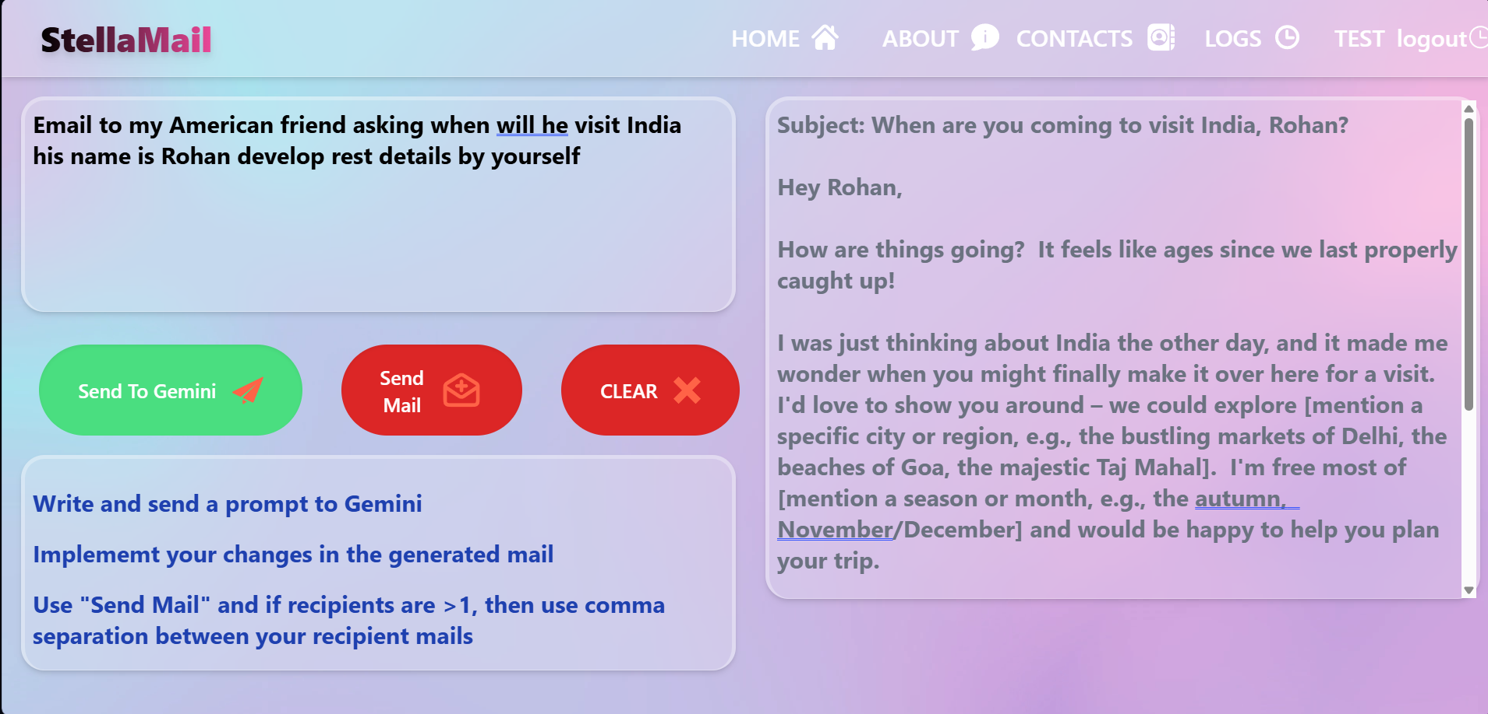
SNAPSHOTS – KEY MODULES AND OUTCOMES
Prompt Submit Snapshot

Slide 20
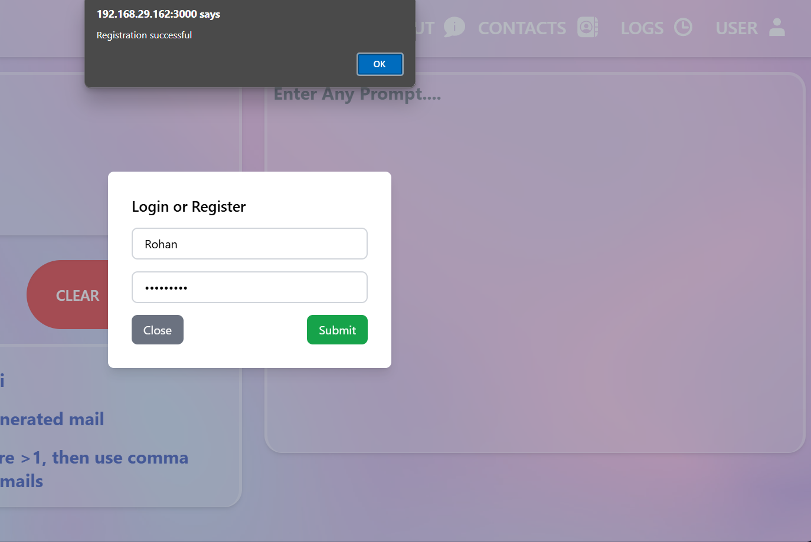
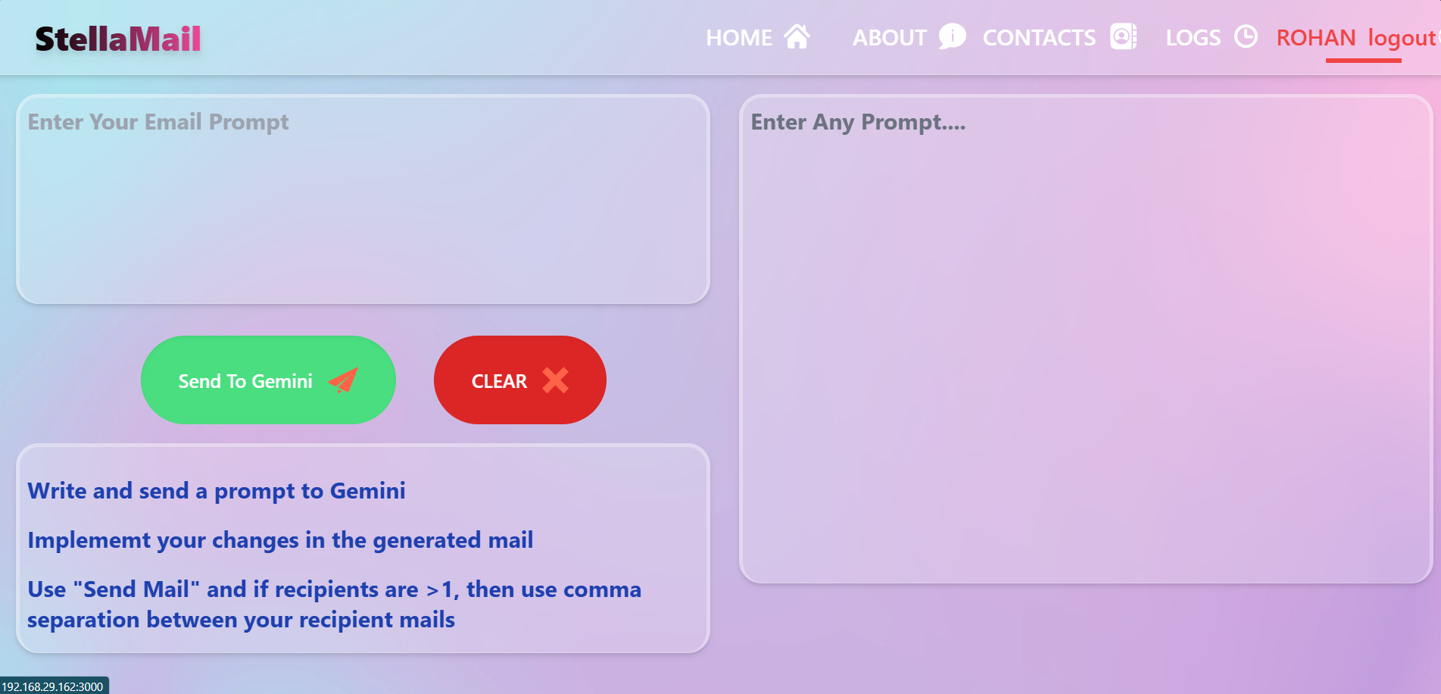
SNAPSHOTS – KEY MODULES AND OUTCOMES
User Login and Authentication

Slide 21
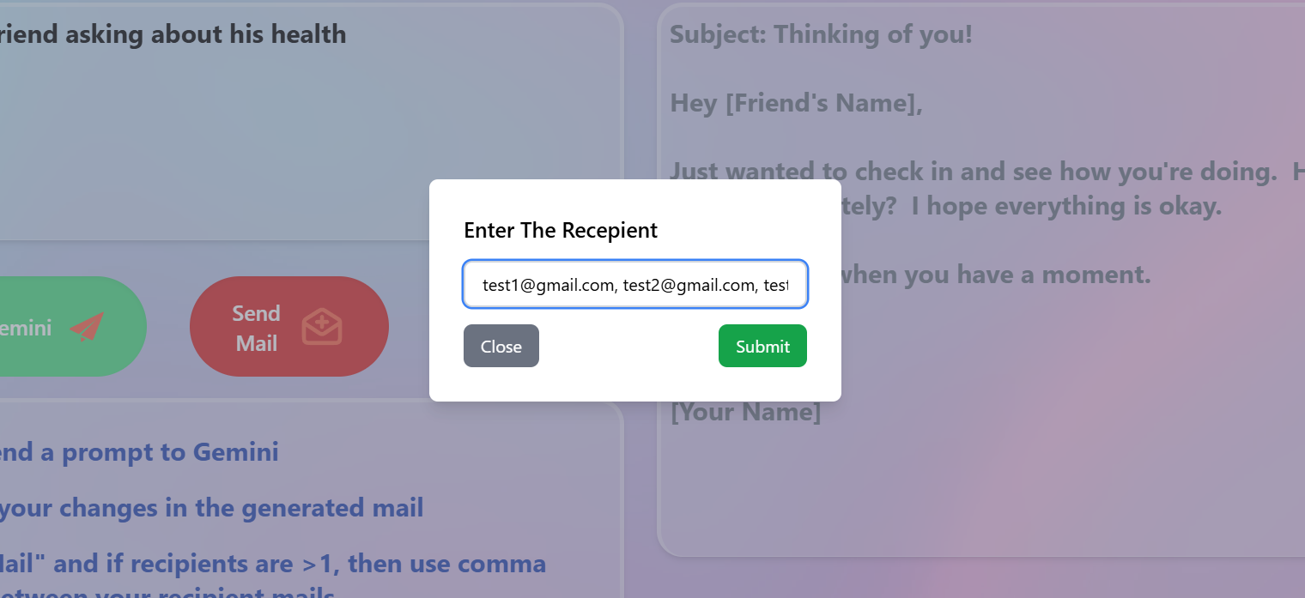
SNAPSHOTS – KEY MODULES AND OUTCOMES
Bulk Email Sending

Slide 22
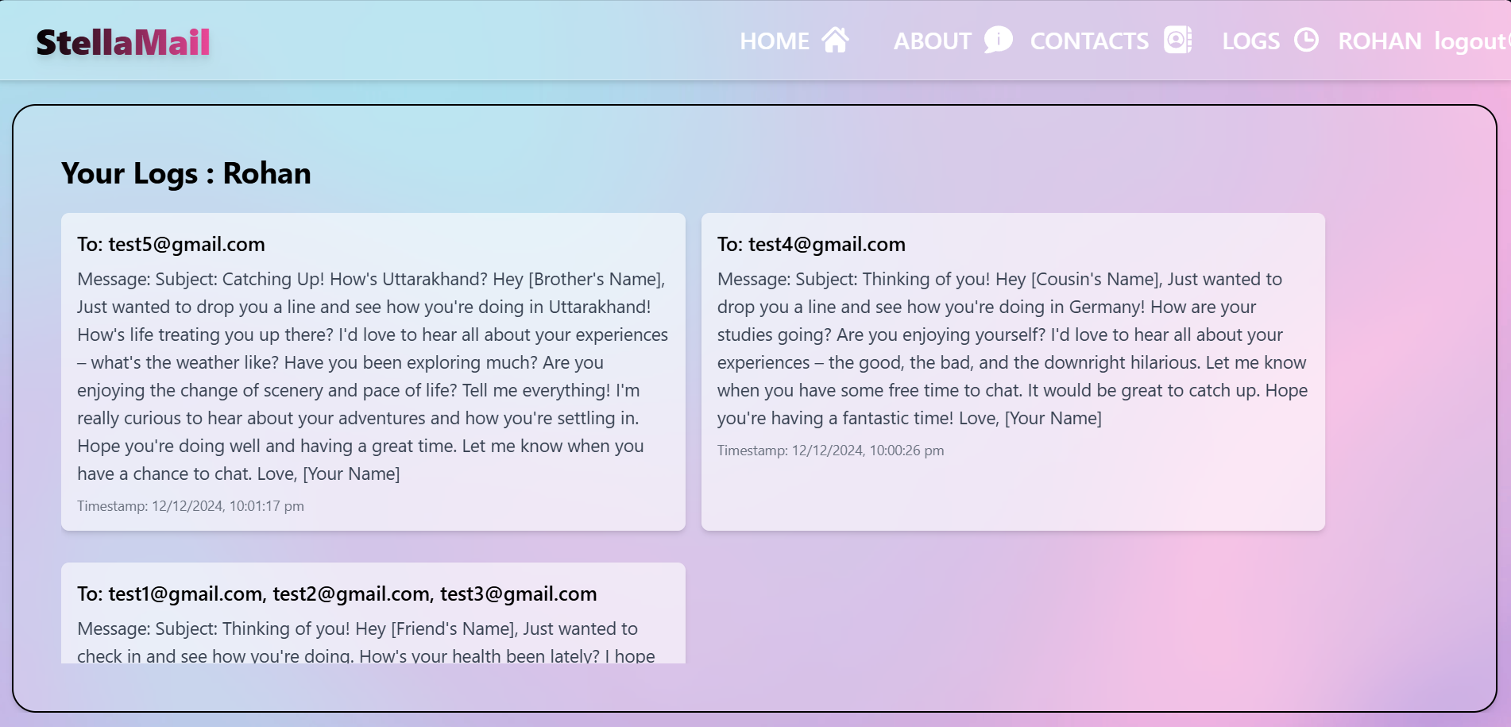
SNAPSHOTS – KEY MODULES AND OUTCOMES
Email Logs

Slide 23
Key Learnings and Challenges
Full-Stack Development: This project provided insights into full-stack development, including the integration of both frontend (React.js) and backend (Node.js/Express.js) components. I learned how to manage client-server communication and the implementation of real-time data handling.
Third-Party API Integration: Integrating the Gemini API for AI-driven email generation taught me how to interact with external services, handle API responses, and ensure the seamless flow of data between the backend and the API.
UI/UX Design and Tailwind CSS: I gained valuable experience in UI/UX design, focusing on creating user-friendly interfaces with React.js. Tailwind CSS was used to build a responsive and clean design efficiently, allowing me to create a modern front-end with minimal custom styling.
Database Management and Logs: Working with MongoDB taught me how to design and manage a flexible, scalable database. I also gained experience in designing database schemas for user data, email drafts, and logs, which is crucial for tracking user activity and debugging.

Slide 24
Future Enhancements
Personalization Features: Implement advanced email personalization, such as dynamic content insertion based on user data or recipient profiles. This could include adding names, custom greetings, or context-based content to make emails more engaging and tailored to recipients.
Error Handling Improvements: Improve error tracking with better user notifications and logging mechanisms for issues like failed email sends or API downtime. Implementing a more robust error management system will help identify root causes and provide users with clear feedback.
Additional Integrations: Integrate additional services, such as calendar scheduling, for further automation in email campaigns. This would allow users to set up automated follow-up emails, schedule reminders, and track interactions with recipients for better engagement.
Performance Optimization: Focus on optimizing the system's performance to handle an increasing number of users and email traffic. This can include optimizing backend API requests, reducing latency, and ensuring the application scales smoothly under heavy load.

Slide 25
Conclusion
Summary: This MERN-based email automation system, powered by Gemini API, offers a user-friendly solution for generating, editing, and sending emails in bulk. It automates the email drafting process and provides detailed logs for monitoring. The system’s flexibility allows users to customize and send emails efficiently, saving both time and effort.
Key Takeaway: The integration of AI-driven content creation enhances email personalization, saving time and improving user productivity. The project also provides valuable insights into full-stack development and working with third-party APIs, while addressing real-world challenges like bulk email sending.
Future Outlook: The system has great potential for future upgrades, including the integration of advanced analytics, better personalization, and additional email-related features. This will ensure the system stays relevant and adaptable to evolving user needs in the realm of email automation.

Slide 26
Acknowledgments
Mentor: I would like to thank my mentor Mr. Ajay Raj Parashar for their guidance and support throughout the development of this project.
Peers: Thanks to my classmates for their feedback and collaborative ideas.
Development Community: Grateful to the online development community, whose resources and forums helped resolve many technical challenges faced during the project.

